Slide 1
ATAI
Advanced Techniqueof Artificial Intelligence
ATAI
ChongqingUniversity _{AdvancedTechniqueof}
of Technology Artificial Intelligence
Chongqing University of
Technology
Chongqing University ^{ATAI}
_{of Technology} Advanced Techniqueof
Artificial Intelligence
Chongqing University of Technology
Chongqing University of Technology
Real-time Emotion Pre-Recognition in Conversations with
Contrastive Multi-modal Dialogue Pre-training
Real-time Emotion Pre-Recognition in Conversations with
Contrastive Multi-modal Dialogue Pre-training
Code:None.
2023.12.6
—— CIKM 2023
Reported by Tingting Zhang
1

Slide 2
ATAI
AdvancedTechniqueof
Artificial Intelligence
ATAI
ChongqingUniversity _{AdvancedTechniqueof}
of Technology Artificial Intelligence
ChongqingUniversity of Technology
Motivation
·SER (Static Emotion Recognition)
Many studies with focus on static emotion recognition, leverage past and future context to speculate the emotion of the existing target utterance in the textual or multi-modal scenario.
·RERC(Real-time Emotion Recognition in Conversations)
Recently, textual and multi-modal approaches observe the practical applications of RERC, which only leverage the past context to detect the target utterance emotion.
·MREPC (Multi-modal Real-time Emotion Pre-recognition in Conversations)
The objective is to predict the emotion of a forthcoming target utterance that is highly likely to occur(lack the target utterance and can only depend on the historical context).
Notes:
这篇论文的动机主要集中在提出一项新的任务——实时情感预识别（MREPC），并试图通过对比多模态对话预训练方法解决这一任务。
静态情感识别（SER）： 之前的研究主要关注静态情感识别，即对已有目标言论的情感进行识别。这种方法通常利用过去和未来的上下文来推测目标言论的情感。
对话中的实时情感识别（RERC）： 针对实时对话中的情感识别，一些研究强调了在对话过程中的实时性。然而，这些方法仍然依赖于过去的上下文来检测目标言论的情感。
实时情感预识别（MREPC）： 与前两者不同，MREPC任务关注的是在目标言论尚不存在的情况下，通过历史对话上下文仅依赖于历史信息来预测可能出现的言论的情感状态。这是一项更具挑战性的任务，因为目标言论尚不存在，只能依赖于历史对话信息。

Slide 3
ATAI
AdvancedTechniqueof
Artificial Intelligence
ATAI
ChongqingUniversity _{AdvancedTechniqueof}
of Technology Artificial Intelligence
ChongqingUniversity of Technology
Motivation
It’s difficult to speculate the emotion of the target utterance, due to the fact that the target utterance is not existing and the historical context can not provide adequate clues for emotion pre-recognition.
While, a complete conversation though unlabelled in Figure 1(b) may greatly supply the empathic information for (a).

Slide 4
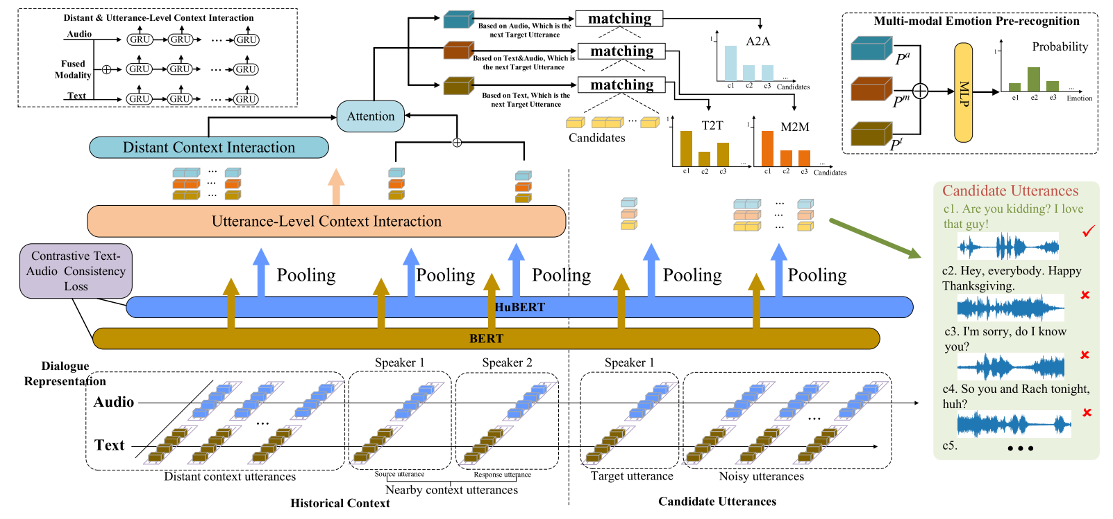
ChongqingUniversity of Technology
ATAI
AdvancedTechniqueof
Artificial Intelligence
ATAI
ChongqingUniversity _{AdvancedTechniqueof}
of Technology Artificial Intelligence
Overview
Notes:
近距离上下文可以动态地关注历史对话中的重要信息（使得近距离上下文能够关注远距离上下文中与情感表达相关的信息）

Slide 5
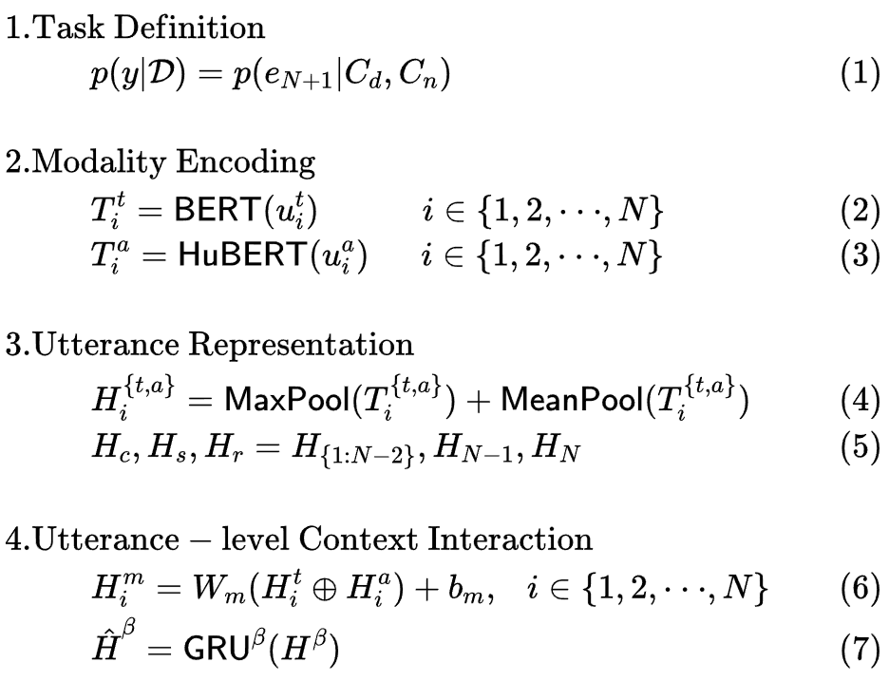
ChongqingUniversity of Technology
ATAI
AdvancedTechniqueof
Artificial Intelligence
ATAI
ChongqingUniversity _{AdvancedTechniqueof}
of Technology Artificial Intelligence
Method

Slide 6
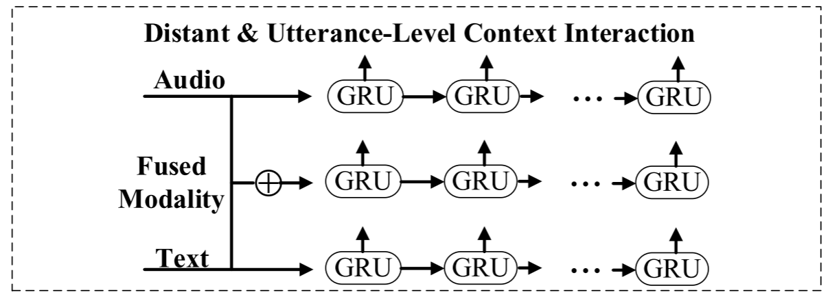
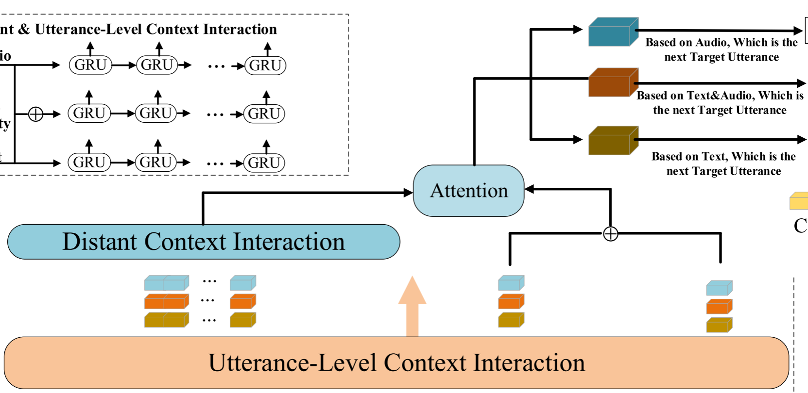
ChongqingUniversity of Technology
ATAI
AdvancedTechniqueof
Artificial Intelligence
ATAI
ChongqingUniversity _{AdvancedTechniqueof}
of Technology Artificial Intelligence
Method
Notes:
P是用于预先识别即将到来的情感的最终表示

Slide 7
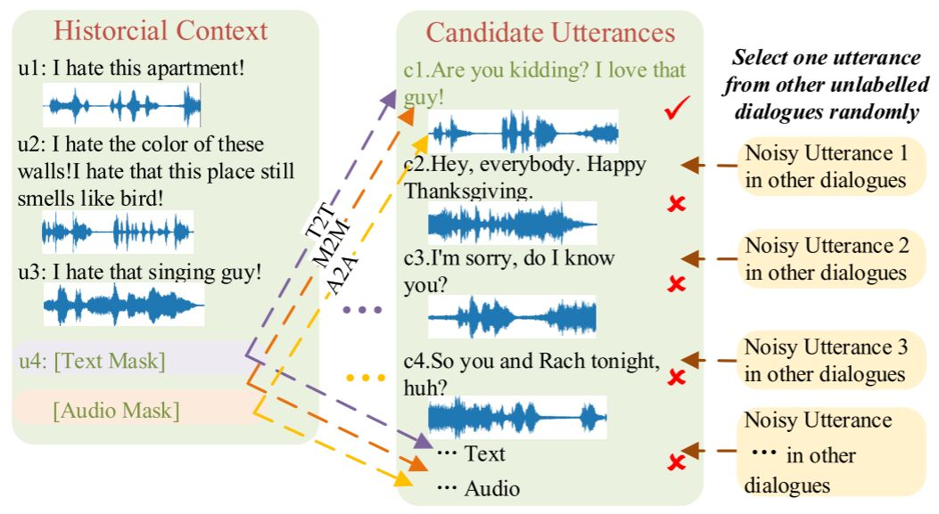
ChongqingUniversity of Technology
ATAI
AdvancedTechniqueof
Artificial Intelligence
ATAI
ChongqingUniversity _{AdvancedTechniqueof}
of Technology Artificial Intelligence
Method

Slide 8
ChongqingUniversity of Technology
ATAI
AdvancedTechniqueof
Artificial Intelligence
ATAI
ChongqingUniversity _{AdvancedTechniqueof}
of Technology Artificial Intelligence
Method

Slide 9
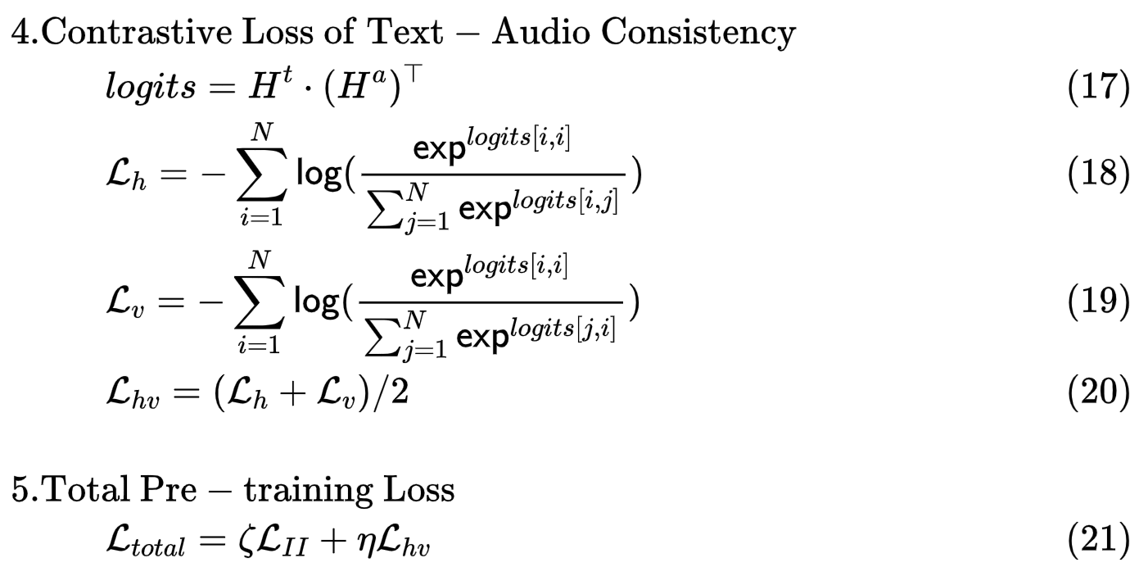
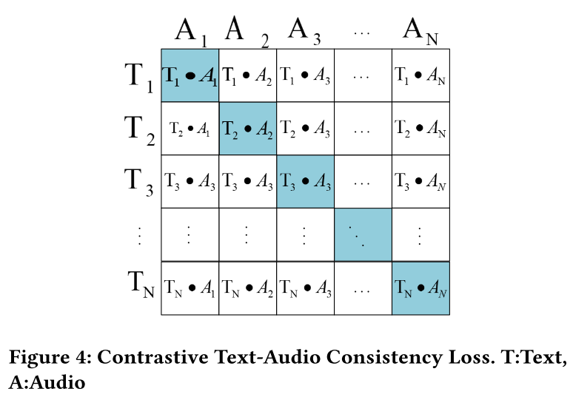
ChongqingUniversity of Technology
ATAI
AdvancedTechniqueof
Artificial Intelligence
ATAI
ChongqingUniversity _{AdvancedTechniqueof}
of Technology Artificial Intelligence
Method
Notes:
由于文本和音频表现出不一致的语义空间，我们试图减轻它们之间的差距。受CLIP的启发，进一步定义了对比损失，以弥合文本和音频之间的一致性。

Slide 10
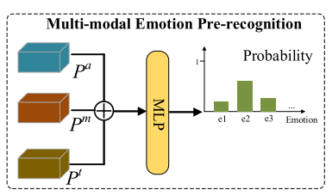
ChongqingUniversity of Technology
ATAI
AdvancedTechniqueof
Artificial Intelligence
ATAI
ChongqingUniversity _{AdvancedTechniqueof}
of Technology Artificial Intelligence
Method
Notes:
softmax Tahn

Slide 11
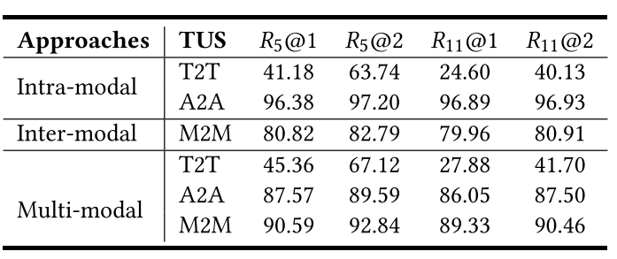
ChongqingUniversity of Technology
ATAI
AdvancedTechniqueof
Artificial Intelligence
ATAI
ChongqingUniversity _{AdvancedTechniqueof}
of Technology Artificial Intelligence
Experiments
Table 3: The performance of target utterance searching (TUS) in pre-training with different perspectives. The intra-modal part comes from our model which only calculates the intra-modal TUS loss (Eq. 14), while the inter-modal part only calculates the inter-modal TUS loss (Eq. 15). Multi-modal part denotes that both the intra- and inter-modal TUS loss are calculated simultaneously (Eq. 16). Note that higher scores mean better experimental results.

Slide 12
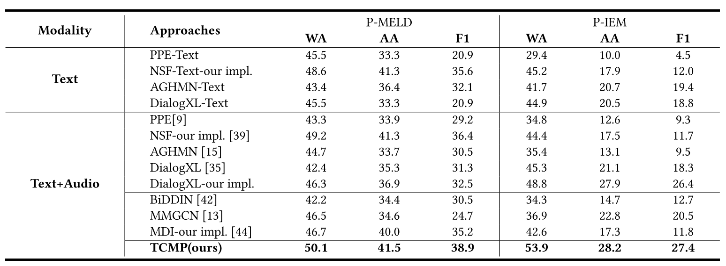
ChongqingUniversity of Technology
ATAI
AdvancedTechniqueof
Artificial Intelligence
ATAI
ChongqingUniversity _{AdvancedTechniqueof}
of Technology Artificial Intelligence
Experiments
Table 4: The performance of different approaches for MREPC task. Text: only utilize textual modality.
our impl.: implementing our modified setting for the corresponding approach.

Slide 13
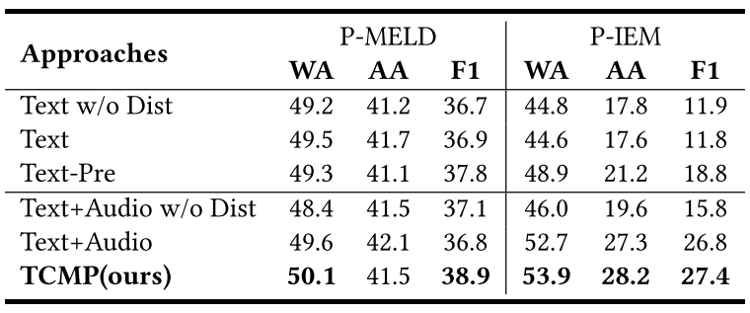
ChongqingUniversity of Technology
ATAI
AdvancedTechniqueof
Artificial Intelligence
ATAI
ChongqingUniversity _{AdvancedTechniqueof}
of Technology Artificial Intelligence
Experiments
Table 5: The performance of single-modal and multi-modal ablated approaches on both datasets.
-Pre denotes the pre-trained approach.
w/o Dist denotes the elimination of distant context.

Slide 14
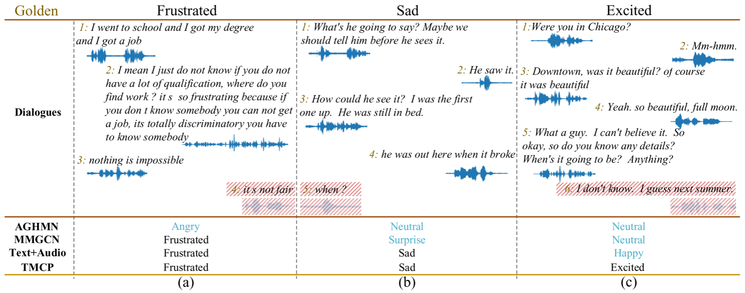
ChongqingUniversity of Technology
ATAI
AdvancedTechniqueof
Artificial Intelligence
ATAI
ChongqingUniversity _{AdvancedTechniqueof}
of Technology Artificial Intelligence
Experiments

Slide 15
ChongqingUniversity of Technology
ATAI
AdvancedTechniqueof
Artificial Intelligence
ATAI
ChongqingUniversity _{AdvancedTechniqueof}
of Technology Artificial Intelligence
Thanks!

